Slide 1
Batch:12
Supervisor: Dr.Annrose J, M.E., Ph.D.
By,
Dani Priya E (962222205016)
Mary Nirmala A (962222205033)
Medolin Christiyana J (962222205036)
Sherin Rickshiya A (962222205053)

Slide 2
ABSTRACT
Rising security challenges demand intelligent surveillance systems capable of real-time threat detection.
An ai-based surveillance framework is proposed to weapons and recognize known criminals from live video streams. Identify
The system leverages yolov8 for weapon detection and deepface for face recognition, integrated through a web-based monitoring platform.
The approach aims to support faster decision-making and improved public safety in high-risk environments.

Slide 3
OBJECTIVE
To design an AI-based surveillance framework for real-time weapon detection.
To develop a face recognition mechanism for identifying known criminals from video feeds.
To integrate deep learning models with a web-based monitoring interface.
To enhance public safety by enabling early threat identification and alert generation.

Slide 4
PROBLEM STATEMENT
Manual monitoring of CCTV surveillance systems is inefficient and prone to human error.
Existing systems often fail to detect weapons and identify criminals in real time, especially in crowded or complex environments.
Delayed detection of threats reduces the ability to prevent crimes before they occur.
There is a need for an intelligent surveillance framework that can automatically detect weapons and recognize known offenders from live video feeds.

Slide 5
HARDWARE & SOFTWARE REQUIREMENTS
Hardware Requirements
USB Camera
Computer System (Laptop/Desktop)
Minimum 8 GB RAM
Processor: Intel i5 or higher / Equivalent
Optional: GPU (for faster processing)
Software Requirements
Operating System: Windows / Linux
Programming Language: Python
Deep Learning Framework: PyTorch
Libraries: YOLOv8, DeepFace, OpenCV
Web Framework: Flask
Development Environment: VS Code / Jupyter Notebook

Slide 6
PROPOSED SYSTEM
An AI-based intelligent surveillance framework for real-time weapon detection and criminal identification.
Live video streams from CCTV/USB cameras are processed using deep learning models.
YOLOv8 is used for accurate and fast weapon detection in surveillance footage.
DeepFace is used for facial recognition by matching faces with a predefined criminal database.
A web-based monitoring interface displays detections and generates instant alerts.
The system supports proactive threat identification to assist security personnel.

Slide 7
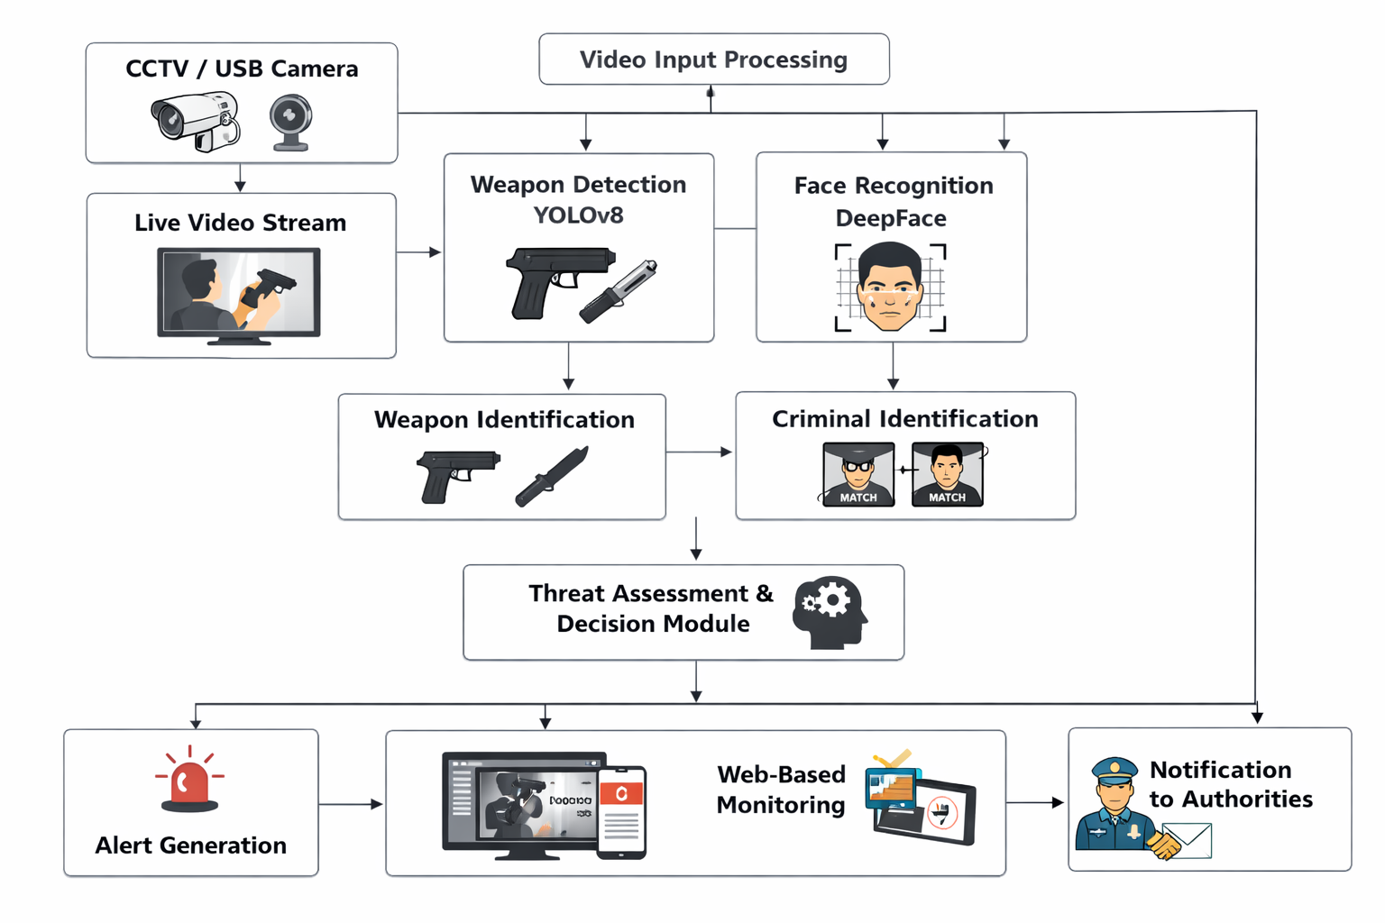
ARCHITECTURAL DESIGN

Slide 8
IMPLEMENTATION MODULES
Main Modules
Video Acquisition Module
Weapon Detection Module (YOLOv8)
Face Recognition Module (DeepFace)
Threat Assessment Module
Web Interface & Alert Module

Slide 9

SAMPLE OUTPUT
Figure 1: Login Page of the Surveillance System

Slide 10
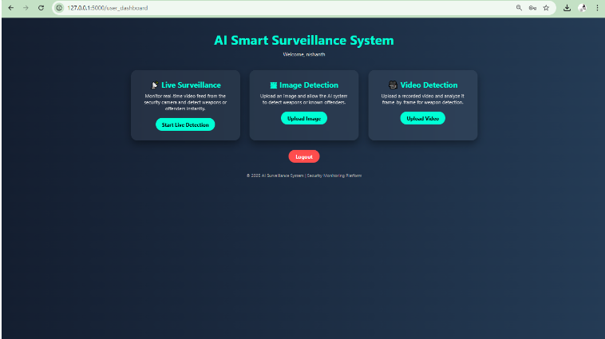
Figure 2: User Dashboard Interface

Slide 11
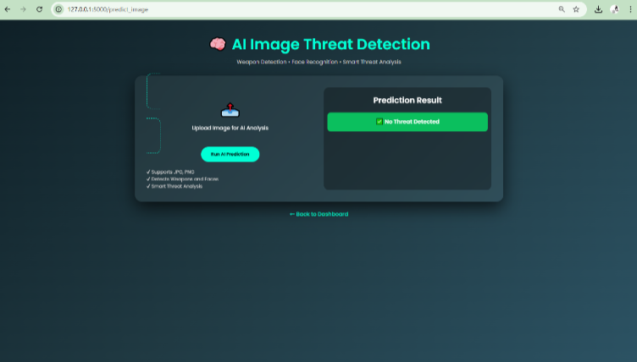
Figure 3: Image Upload Interface

Slide 12
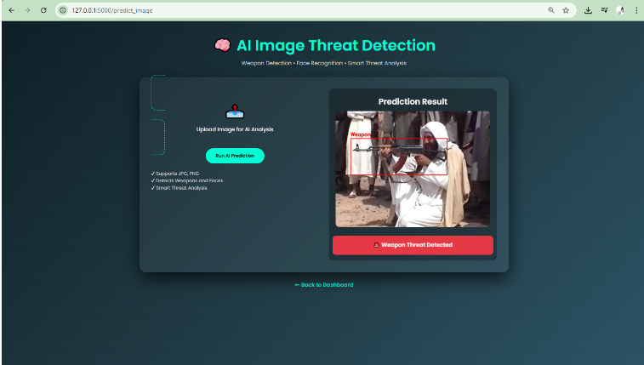
Figure 4: Image Prediction Result Showing Weapon Detection

Slide 13
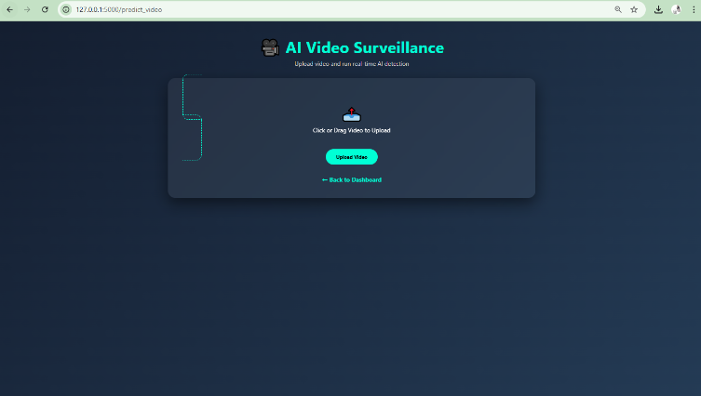
Figure 5: Video Upload Interface

Slide 14
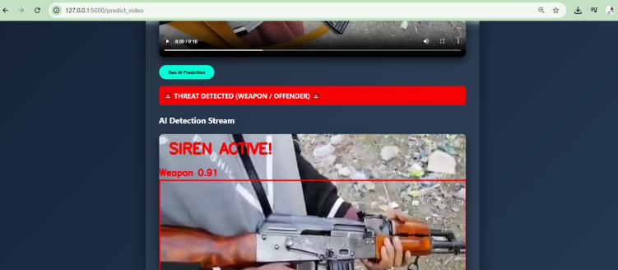
Figure 6: Video Prediction Result

Slide 15

Figure 7: Offender Upload Interface

Slide 16

Figure 8: Authorized Personnel Upload Interface

Slide 17
CONCLUSION
An AI-based intelligent surveillance framework has been designed for real-time weapon detection and criminal identification.
Deep learning models such as YOLOv8 and DeepFace enable automated threat analysis from live video streams.
The integrated system supports proactive monitoring and assists security personnel in faster decision-making.
The proposed approach contributes toward smarter, technology-driven public safety solutions.

Slide 18
REFERENCES
[1] W. Hu, T. Tan, L. Wang, and S. Maybank, “A survey on visual surveillanceof object motion and behaviors,” IEEE Transactions on Systems, Man, andCybernetics, vol. 34, no. 3, pp. 334–352, Aug. 2004.
[2] M. Valera and S. Velastin, “Intelligent distributed surveillance systems: Areview,” IEE Proceedings - Vision, Image and Signal Processing, vol. 152, no 2, pp. 192–204, Apr. 2005.
[3] B. Gregory and J. Lee, “Weapon detection using deep learning for smartsurveillance systems,” International Journal of Computer Vision Applications,vol. 10, no. 2, pp. 45–52, 2018.
[4] S. Verma and R. Gupta, “Real-time weapon detection using YOLO deeplearning algorithm,” International Journal of Computer Applicationsvol. 176,no. 24, pp. 21–26, 2020.

Slide 19
REFERENCES
[5] J. Redmon, S. Divvala, R. Girshick, and A. Farhadi, “You Only Look Once:
Unified, real-time object detection,” in Proc. IEEE Conference on Computer
Vision and Pattern Recognition (CVPR), 2016, pp. 779–788.
[6] J. Redmon and A. Farhadi, “YOLOv3: An incremental improvement,” arXiv
preprint arXiv:1804.02767, 2018.
[7] F. Schroff, D. Kalenichenko, and J. Philbin, “FaceNet: A unified embedding
for face recognition and clustering,” in Proc. IEEE Conference on Computer
Vision and Pattern Recognition (CVPR), 2015, pp. 815–823.
[8] O. Parkhi, A. Vedaldi, and A. Zisserman, “Deep face recognition,” in Proc.
British Machine Vision Conference (BMVC), 2015.

Slide 20
REFERENCES
[9] S. I. Serengil and A. Ozpinar, “DeepFace: A lightweight face recognitionand facial attribute analysis framework for Python,” IEEE Access, vol. 8, pp.156–166, 2020.
[10] W. Sultani, C. Chen, and M. Shah, “Real-world anomaly detection insurveillance videos,” in Proc. IEEE Conference on Computer Vision andPattern Recognition (CVPR), 2018, pp. 6479–6488.
[11] K. Zhang, Z. Zhang, Z. Li, and Y. Qiao, “Joint face detection andalignment using multitask cascaded convolutional networks,” IEEE SignalProcessing Letters, vol. 23, no. 10, pp. 1499–1503, 2016.
[12] M. Ribeiro, S. Singh, and C. Guestrin, “Why should I trust you?Explaining the predictions of any classifier,” in Proc. ACM SIGKDDInternational Conference on Knowledge Discovery and Data Mining, 2016, pp.1135–1144.

Slide 21
REFERENCES
[13] X. Wang, R. Girshick, A. Gupta, and K. He, “Non-local neural networksfor video classification,” in Proc. IEEE Conference on Computer Vision andPattern Recognition (CVPR), 2018.
[14] S. Shinde and R. Kamat, “Web-based smart surveillance system usingmachine learning,” International Journal of Advanced Computer Science andApplications, vol. 12, no. 4, pp. 234–241, 2021.
[15] D. Patel and K. Shah, “Machine learning based intelligent securitymonitoring system,” International Journal of Engineering Research &amp;Technology, vol. 11, no. 5, pp. 765–770, 2022.
[16] A. Khan, A. Sohail, U. Zahoora, and A. Qureshi, “A survey of the recentarchitectures of deep convolutional neural networks,” Artificial IntelligenceReview, vol. 53, no. 8, pp. 5455–5516, 2020.

Slide 22
REFERENCES
[17] L. Chen and Y. Li, “Real-time weapon detection using improved YOLOdeep learning architecture,” IEEE Access, vol. 11, pp. 45231–45242, 2023.
[18] P. Rao and S. Kumar, “Hybrid surveillance system combining facialrecognition and weapon detection,” International Journal of Intelligent Systemsand Applications, vol. 14, no. 2, pp. 78–87, 2022.
[19] A. Singh and V. Sharma, “Deep learning based real-time surveillancesystem for crime detection,” International Journal of Computer Science andInformation Security, vol. 21, no. 3, pp. 112–119, 2023.
[20] W. Liu, D. Anguelov, D. Erhan, C. Szegedy, and S. Reed, “SSD: Singleshot multibox detector,” in Proc. European Conference on Computer Vision(ECCV), 2016, pp. 21–37.

Slide 23
THANK YOU

